Slide 1
Path Planning for Lynx Robots on ROS/Gazebo
Group 8
Yuwei Wu, Weiqi Chen, Min wang

Slide 2
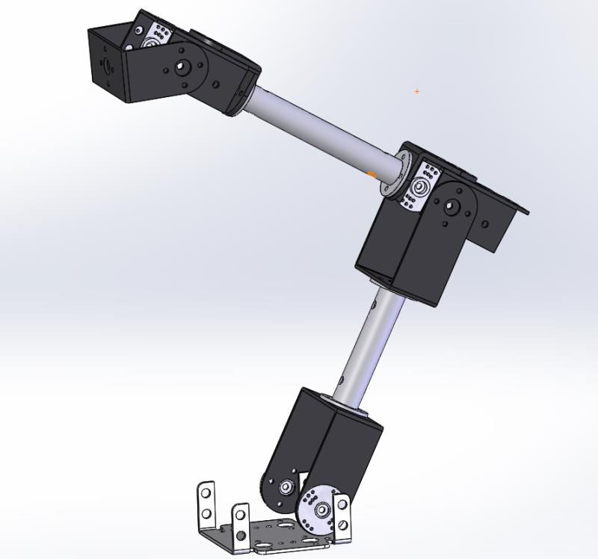
1.Problem Definition
Implementing the simulation of the Lynxmotion robot from MATLAB to Robot Operating System and Gazebo
Implement and compare path planning algorithms (RRT, RRT*, SST) on ROS

Slide 3
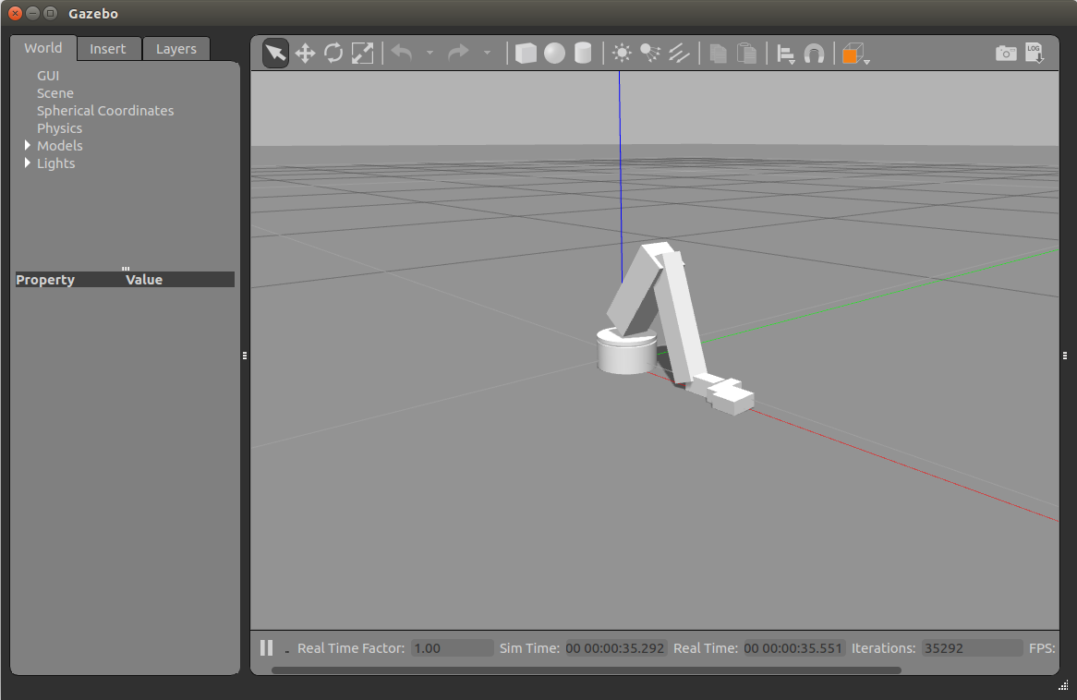
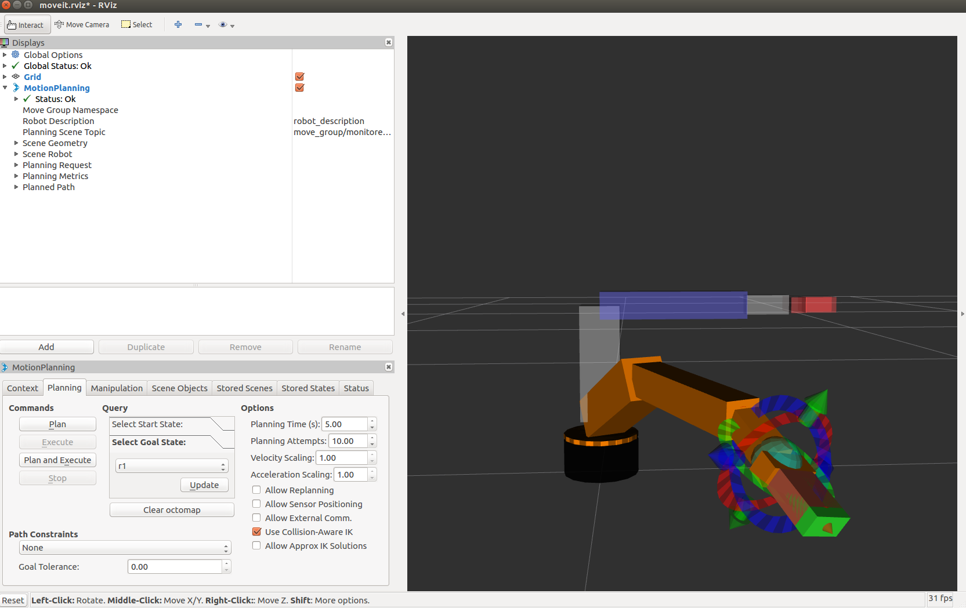
2.Results
Gazebo model of lynxmotion robot
Achieve motion planning in Moveit!

Slide 4
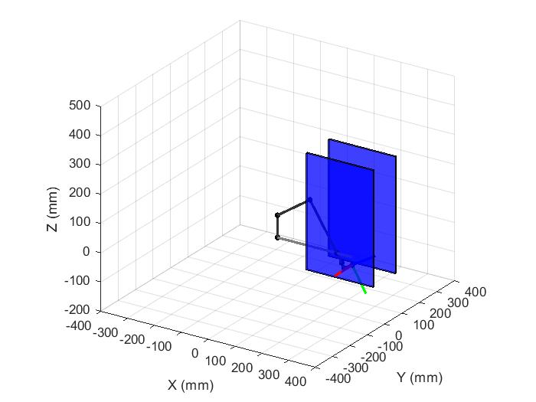
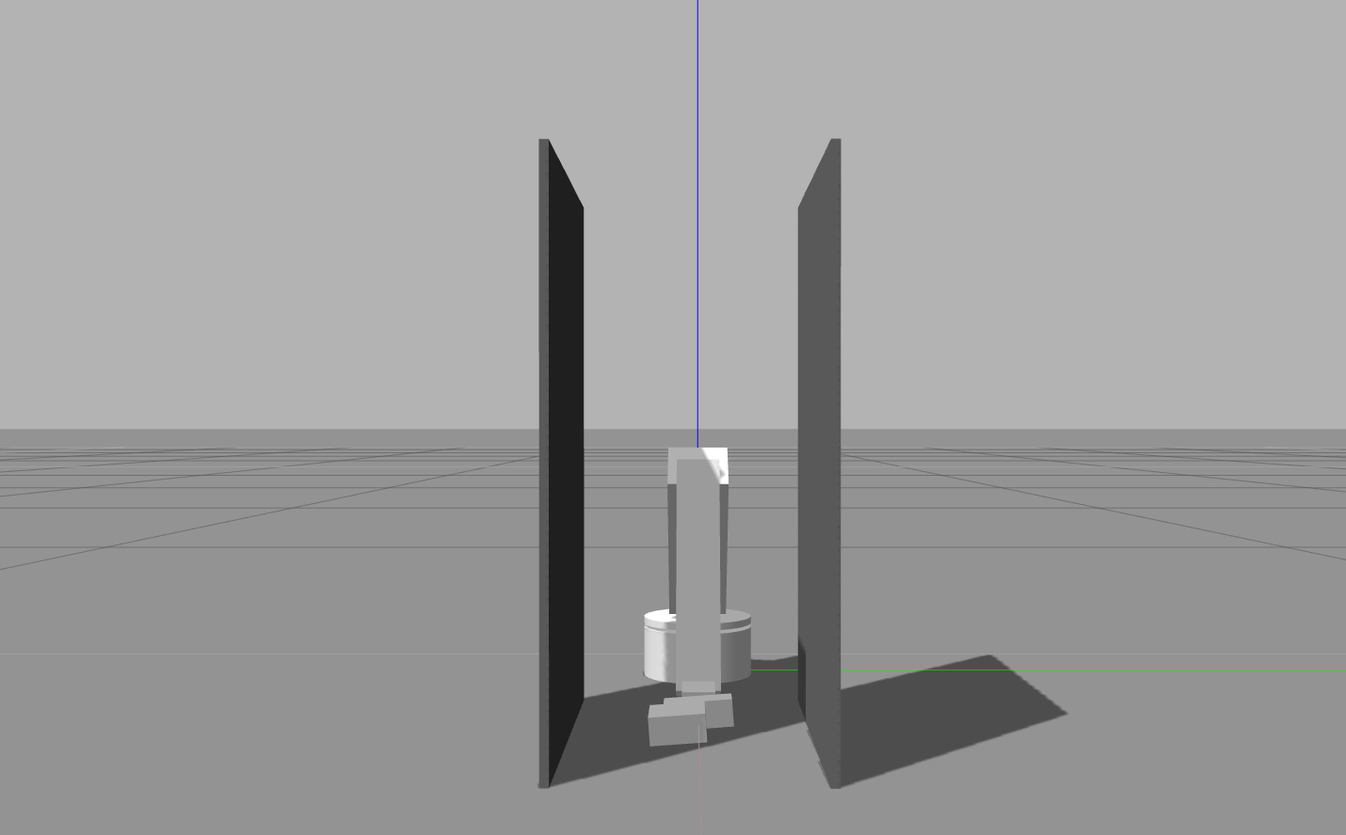
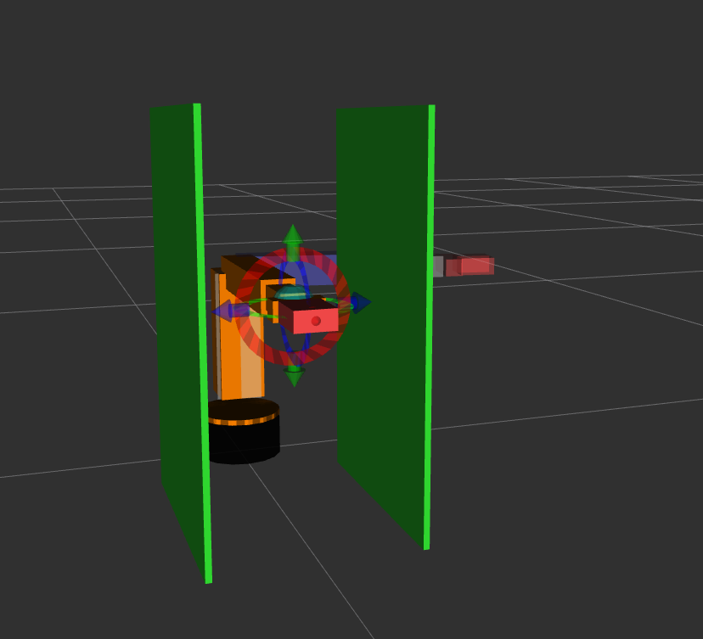
2.Results
Add static obstacles
map2

Slide 5
2.Results
Conduct the planning result
Map2
start =[0,0,0,0,0,0] goal = [1.4,0,0,0,0,0]

Slide 6
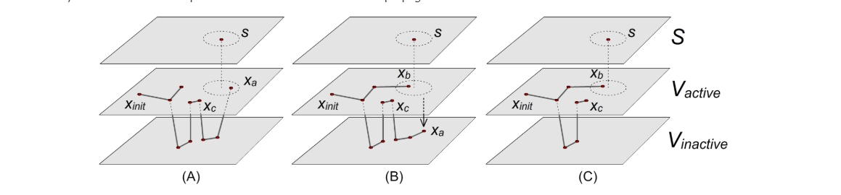
2.Results
Method | RRT | RRT* | SST
Optimality | Provably suboptimal | Asymptotically Optimal | Asymptotically Near-Optimal
Data Structure Size | All nodes are retained | All nodes are retained | Sparse Data Structure/Converges to all collision free samples

Slide 7
3. Lessons Learned & Remaining Challenges
Configuring a new working environment can take longer than planned
Implement RRT * and SST for performance comparison and analysis
(We are working on the conversion of SST to ros/gazebo platform)

